Slide 1
Currency Exchange Rate Fluctuations and Their Impact on Container Imports into Kenya
A Data-driven Analysis

Slide 2

Introduction
Brief overview of Kenya's reliance on imports.
Importance of understanding the relationship between currency exchange rate fluctuations and cargo imports.
Research objectives:
Investigate whether KES-USD fluctuations significantly influence container import volumes.
Test the hypothesis that there is little to no effect or only a weak positive correlation.

Slide 3
Background and Context
Kenya imported goods worth approximately USD 15 billion in 2023, with over 70% denominated in USD (KNBS, 2023).
Increased volatility in the Kenyan Shilling (KES) against the US Dollar (USD) due to:
Rising global interest rates.
Geopolitical tensions.
Internal fiscal pressures.
Essential imports (e.g., fuel, machinery, medical supplies) often exhibit inelastic demand.

Slide 4

Literature Review
Global Perspectives:
Exchange rate volatility impacts trade differently depending on the nature of goods traded.
Stable exchange rates enhance trade by reducing uncertainties (Rose, 2000).
Emerging economies show resilience to moderate currency fluctuations due to essential imports (Akhtar et al., 2013).

Slide 5
Literature Review
Regional Perspectives:
In Kenya, essential imports like fuel and medical supplies are less sensitive to exchange rate changes (Ndungu, 2021).
Regional trade agreements can mitigate the impact of currency fluctuations (Kiraka, 2019).

Slide 6
Literature Review
Theoretical Framework:
Marshall-Lerner condition: Currency depreciation improves trade balance if price elasticities of demand for exports and imports exceed one.
J-curve effect: Trade balances may worsen before improving following currency depreciation.

Slide 7
Methodology
Data Collection:
Daily KES-USD exchange rates from Yahoo Finance.
Monthly container import volumes from Kenya Ports Authority (KPA).
Sampling Period: January to November 2024.
Analysis Techniques:
Visualization of trends.
Pearson correlation coefficients.
Ordinary Least Squares (OLS) regression model.

Slide 8
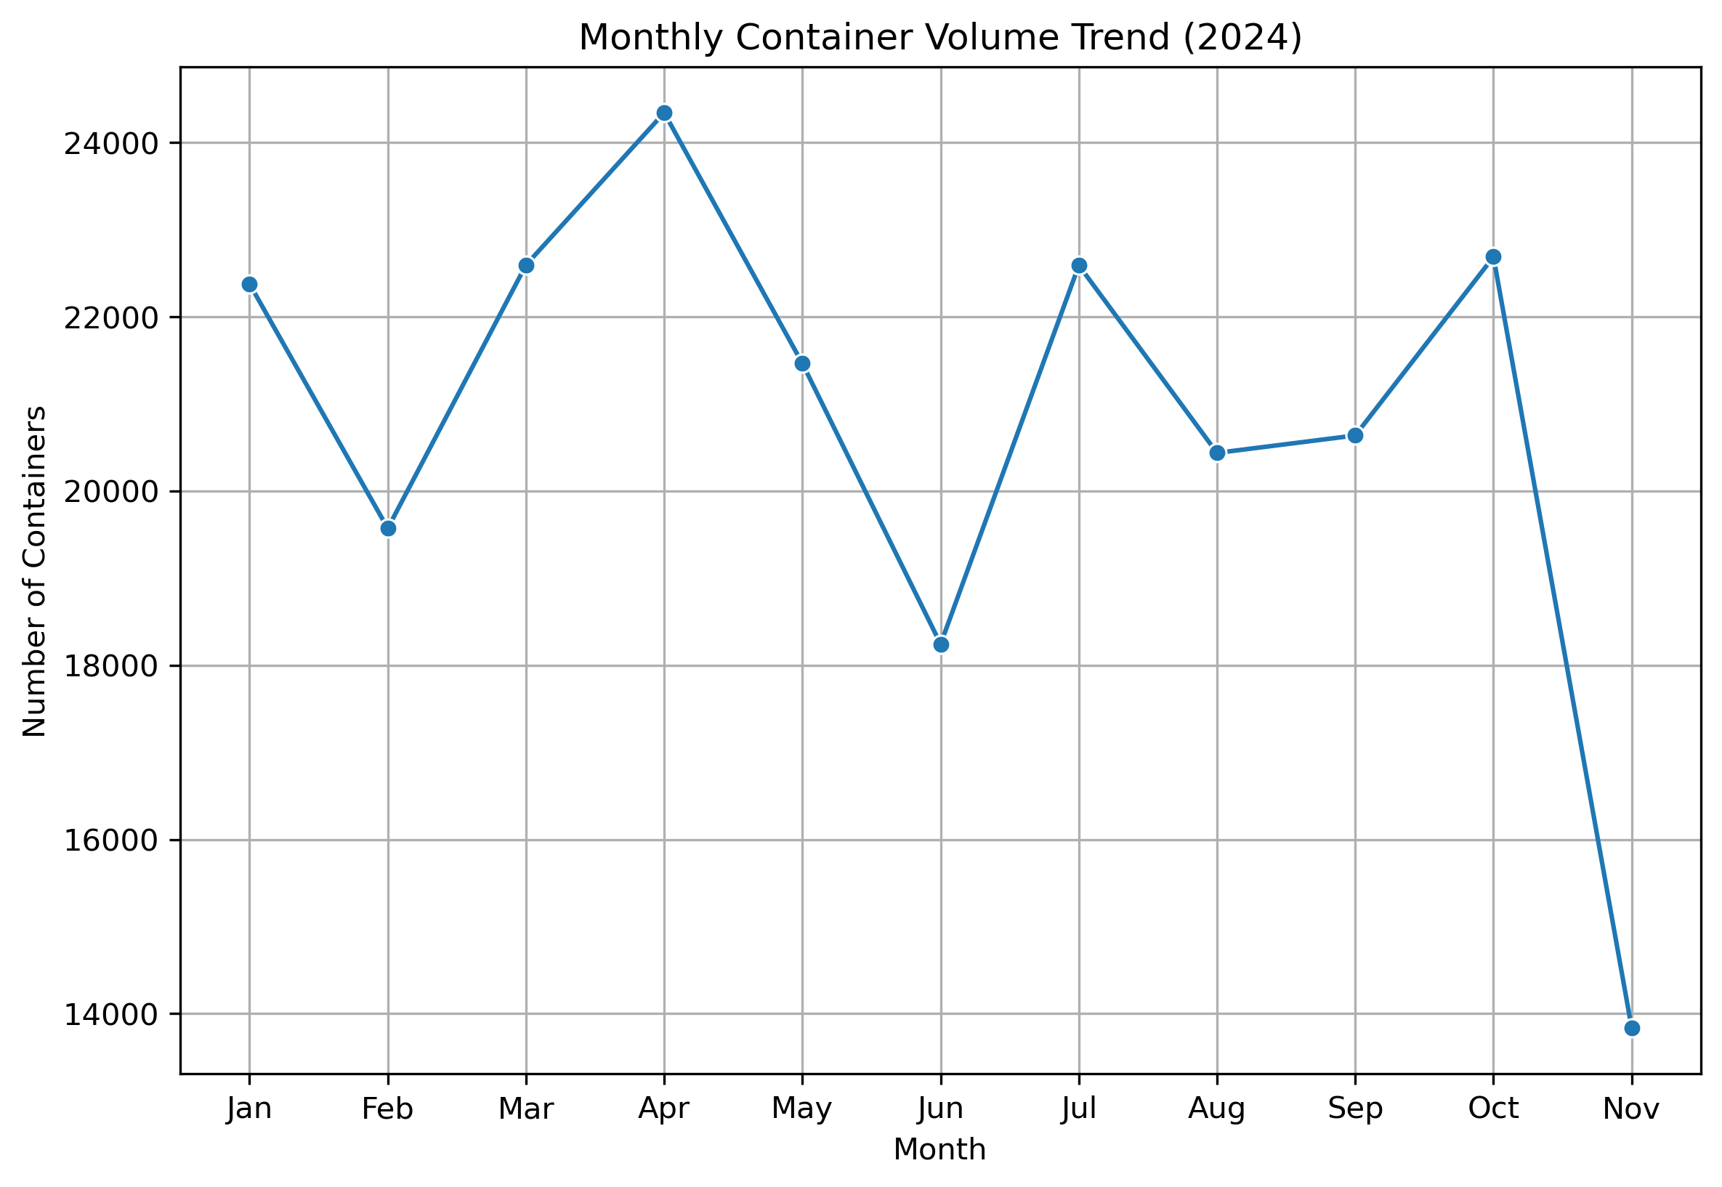
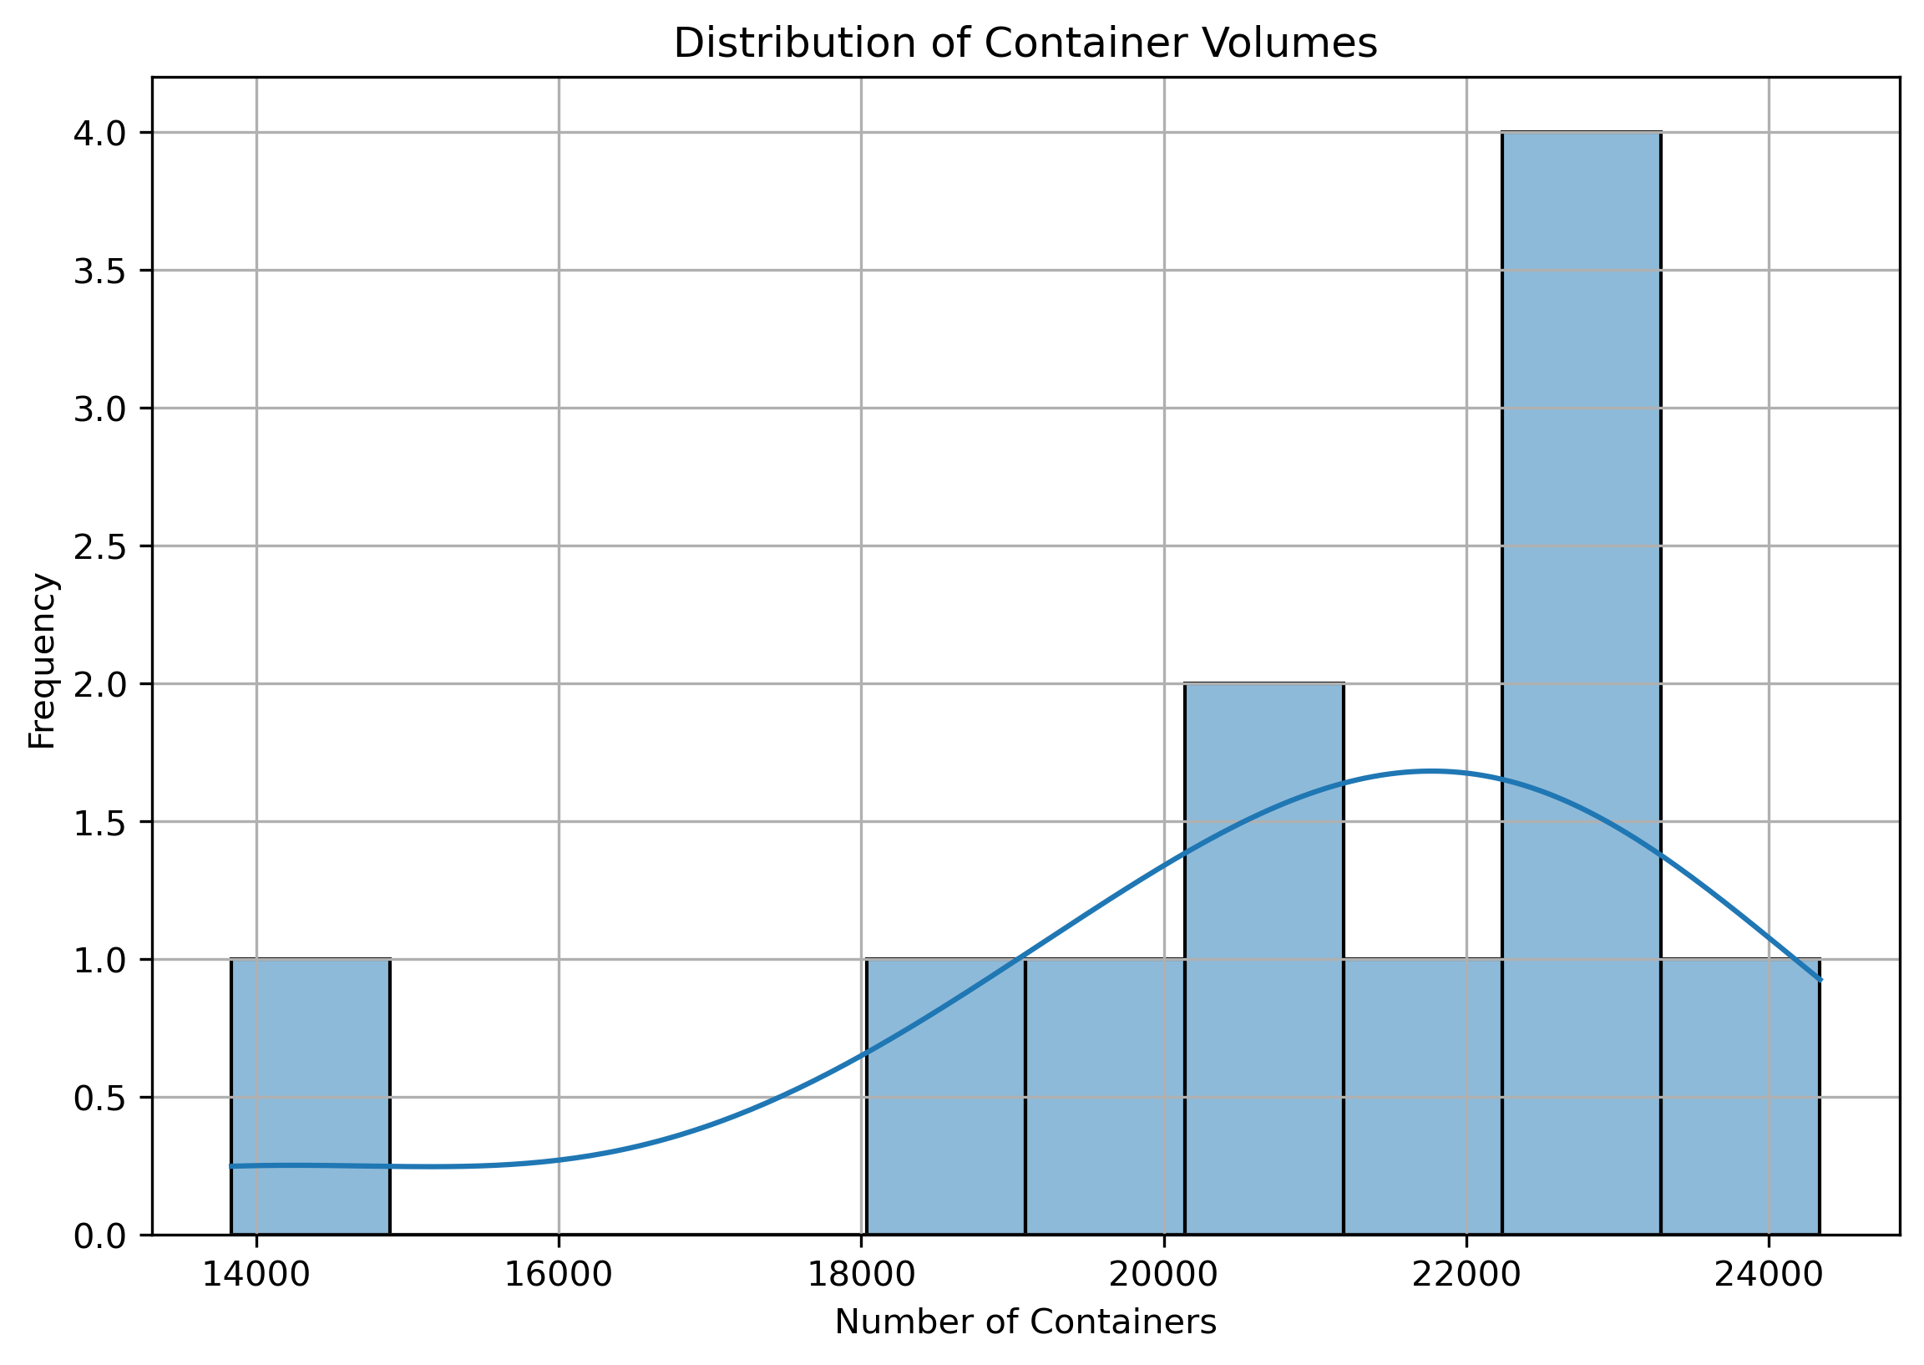
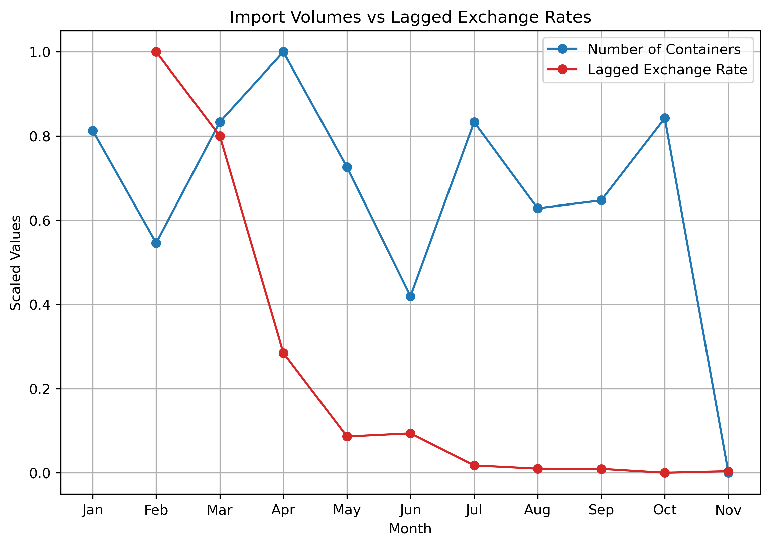
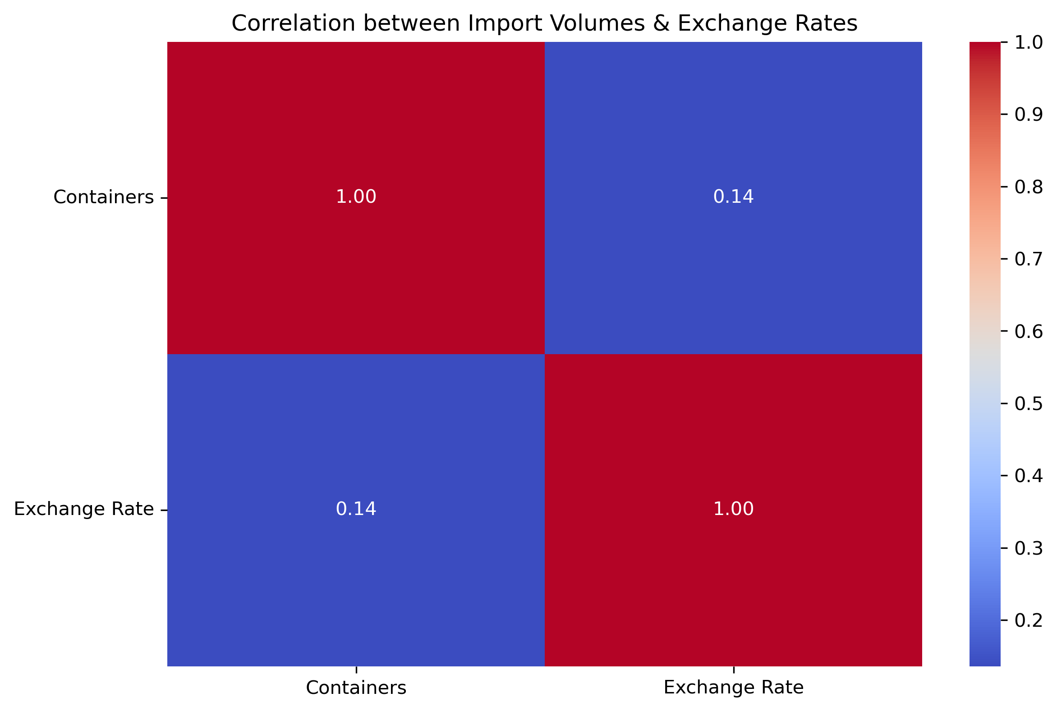
Key Findings – Visual Insights
Significant USD/KES volatility in early 2024, stabilizing later in the year.
Container import volumes remained relatively stable despite exchange rate fluctuations.
Distribution of exchange rates was slightly right-skewed, indicating periods of lower values with occasional spikes.

Slide 9
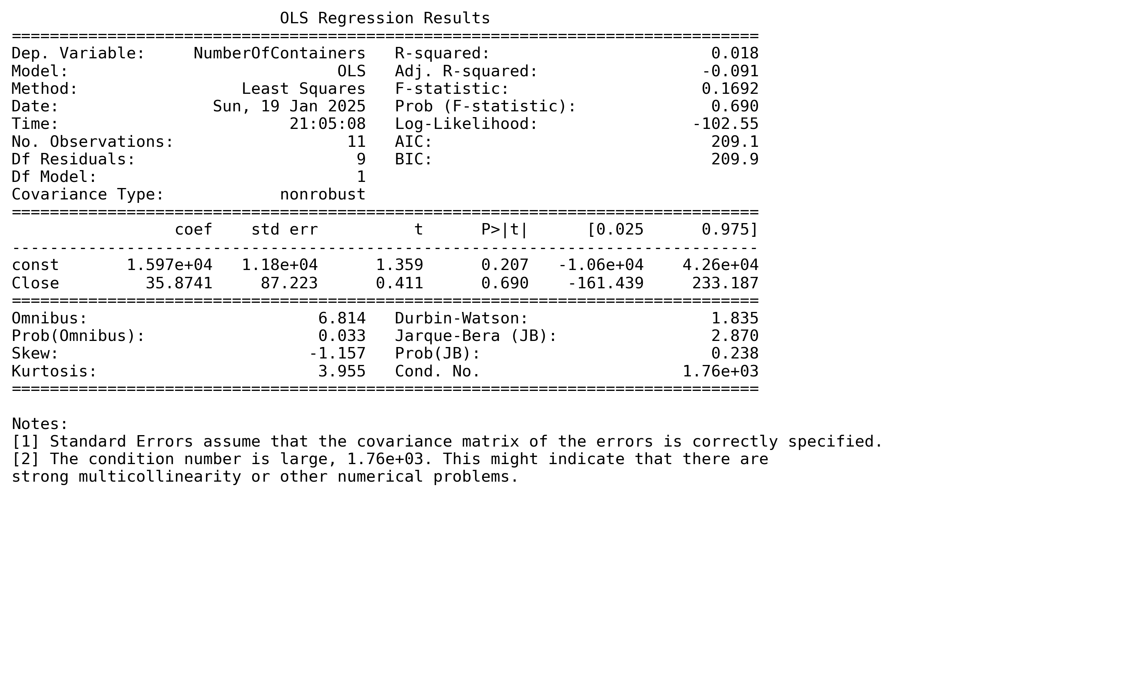
Statistical Analysis
Pearson correlation coefficient revealed a weak positive correlation between KES-USD exchange rate and container import volumes.
OLS Regression Results:
Coefficient for exchange rate ('Close'): 35.8741.
R-squared value: 0.018 (only 1.8% of variation explained by exchange rate fluctuations).
P-value for 'Close': 0.690 (not statistically significant).

Slide 10
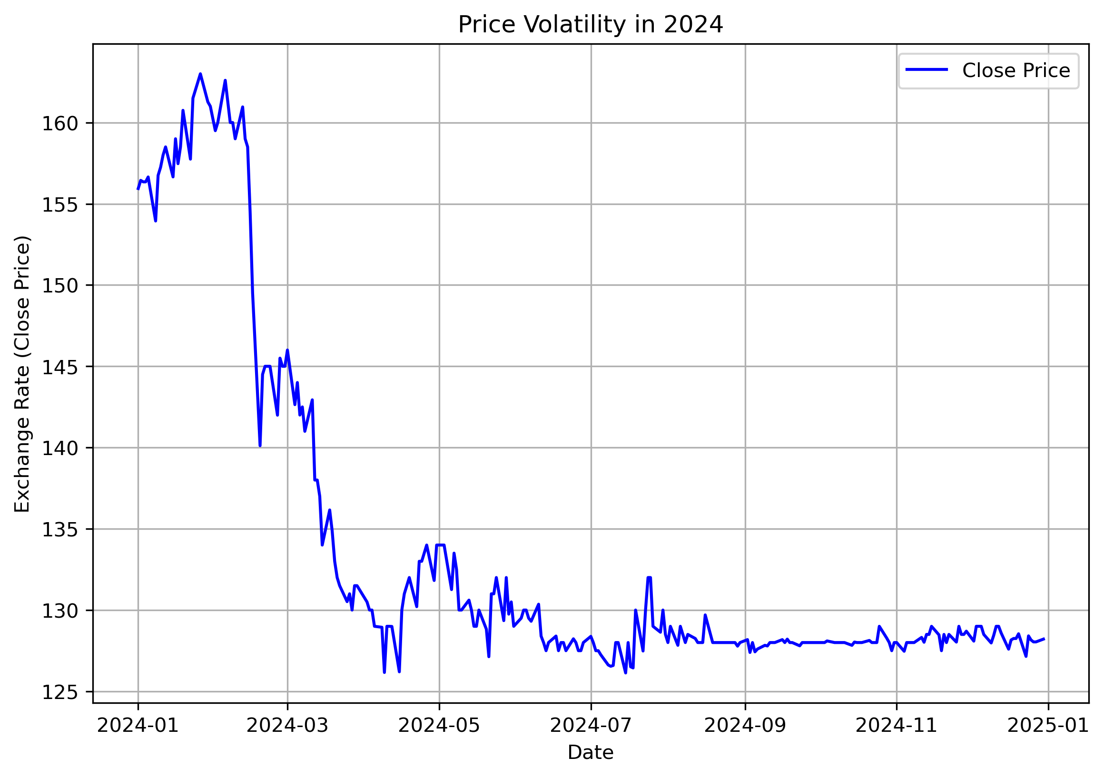
Discussion of Results
Weak positive relationship between exchange rate fluctuations and import volumes.
Factors influencing stability of import volumes:
Inelastic demand for essential goods.
Hedging strategies employed by import-dependent businesses.
Potential delayed effects of currency depreciation (J-curve effect).

Slide 11
Implications
Policy Implications:
Focus on stabilizing macroeconomic conditions and supporting essential imports.
Strengthen regional trade agreements to reduce dependency on external currencies.
Business Strategies:
Adopt hedging strategies to manage currency risks.
Diversify supply chains to reduce reliance on a single currency.

Slide 12
Limitations
Future Research
Limited data (11 months).
Non-stationarity of exchange rate data (spurious regression results possible).
Simplistic model with only one independent variable.
Expand sample size to include more data points.
Use differencing or transformation techniques to address non-stationarity.
Include additional variables such as GDP, inflation, and trade policies in the model.

Slide 13
Conclusion
Currency depreciation does not directly reduce import activity in Kenya.
Other factors, such as inelastic demand for essential goods and hedging strategies, play a more significant role.
Policymakers and businesses must adopt context-specific approaches to manage trade dynamics effectively.

Slide 14

The end: Q & A

